Slide 1
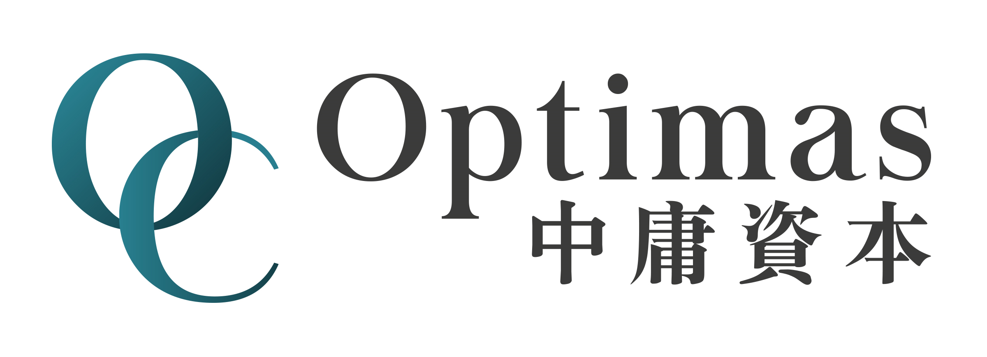
Summer Intern Presentation
Aug 2024
Lucas Lu

Slide 2
Contents
Neural Network on Crypto Currency
Deep Reinforcement Learning on CSI300
Technical Indicator on Crypto Currency

Slide 3
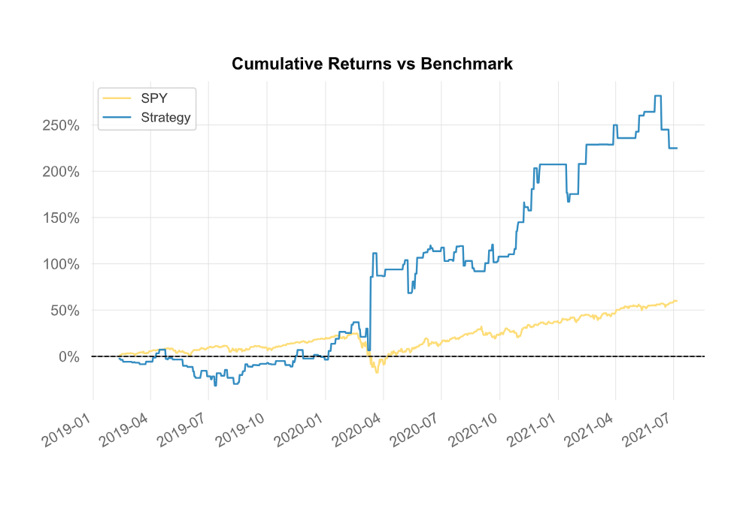
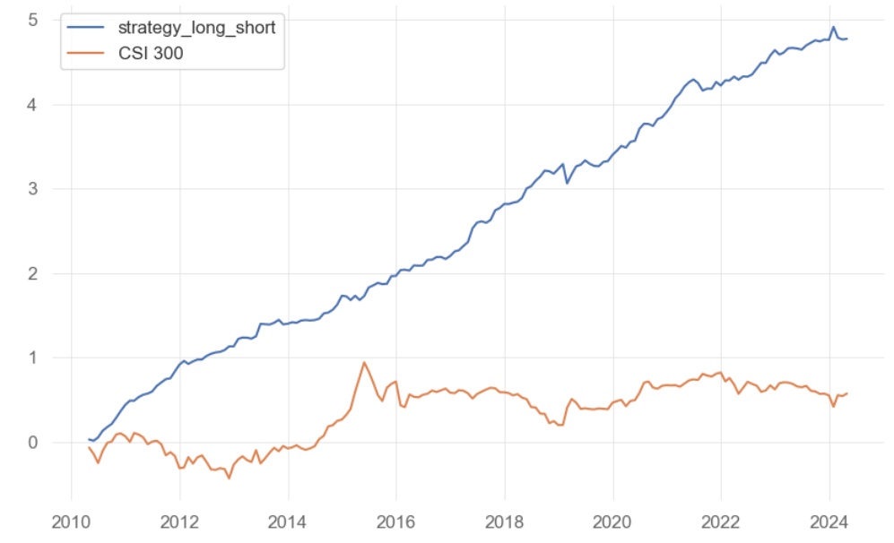
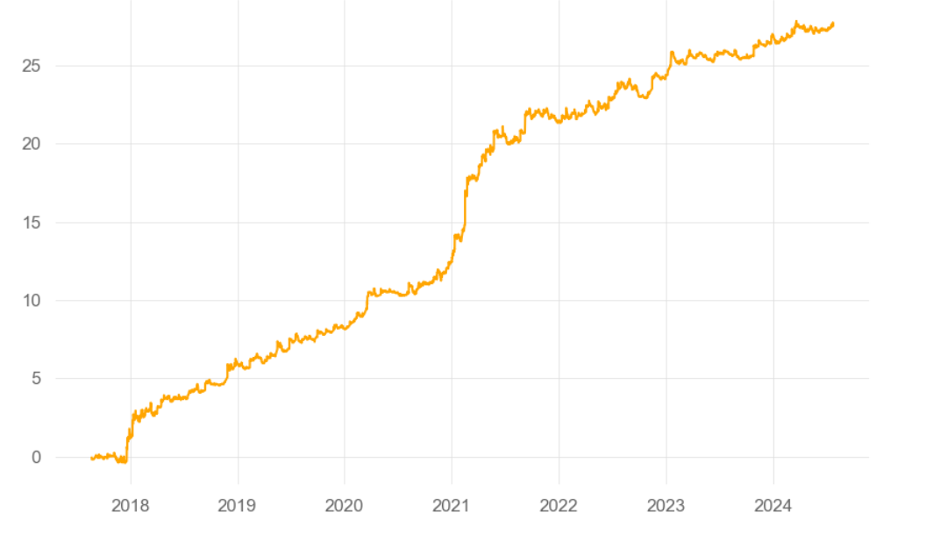
Results Display
Neural Network on Crypto Currency
Deep reinforcement Learning on CSI300
Technical Indicator on Crypto Currency

Slide 4
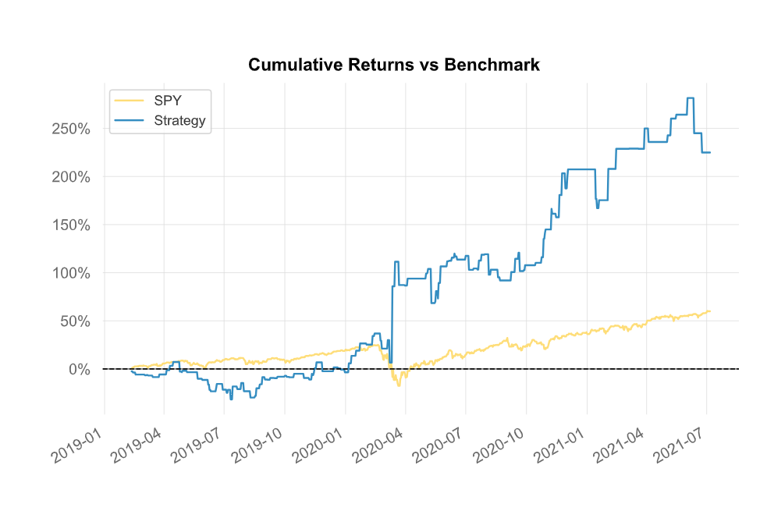
Neural Network
Long_short daily BTC
Run 7 Neural Network Models to predict the next day close price. Long the bitcoin if there are more than half of the model have the long signal. Short the bitcoin if there are more than half of the signal has the short signal.
Sharpe Ratio:0.87
CAGR:41.4%
Max Drawdown:-36.33%

Slide 5
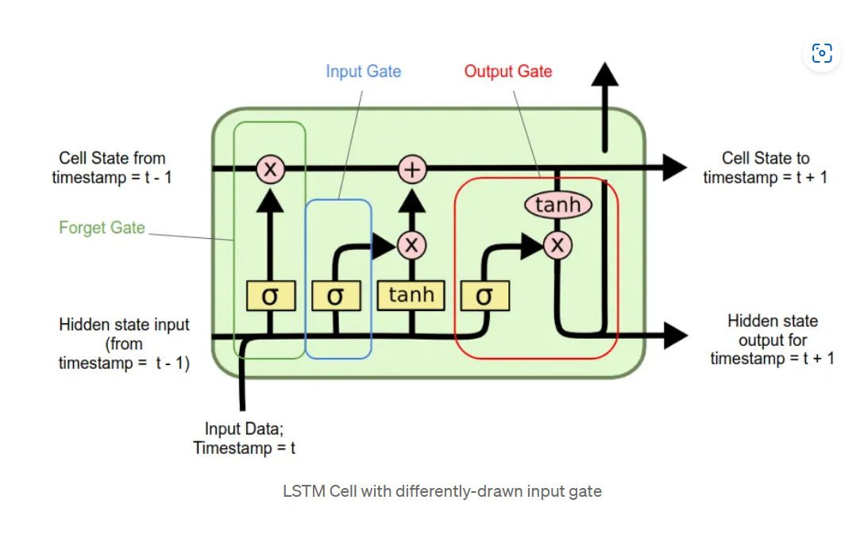
Neural Network
7 neural networks I use:
LSTM
BD_LSTM
CNN
MLP
ED_LSTM
Convolutional_LSTM
ARIMA (one dimension)

Slide 6
Neural Network – Strategy
Strategy Outlook
I take open, high, low, volume as the dependent variables, and I predict the next day close price.
The model will take last several days (vary by person) of data as input and output prediction for the next several days (vary by person).
Ex. I pick the last 5 days as input and predict the next day close price. You can also make it predicts the next 12 days or any days greater than 1 day.
If the predicted t+1 close price is higher than the t+1 open price of the bitcoin, then the model produces the long signal. Otherwise, it produces the short signal.
Codes: https://github.com/yilu0624/Crypto-Nerual-Network.git

Slide 7
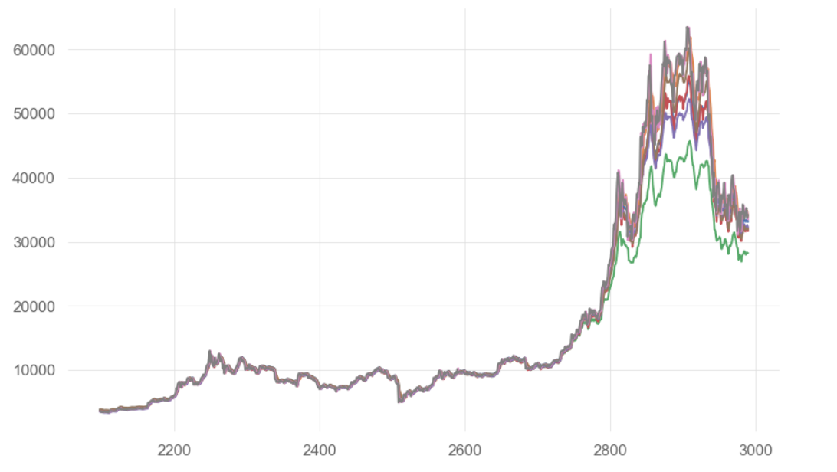
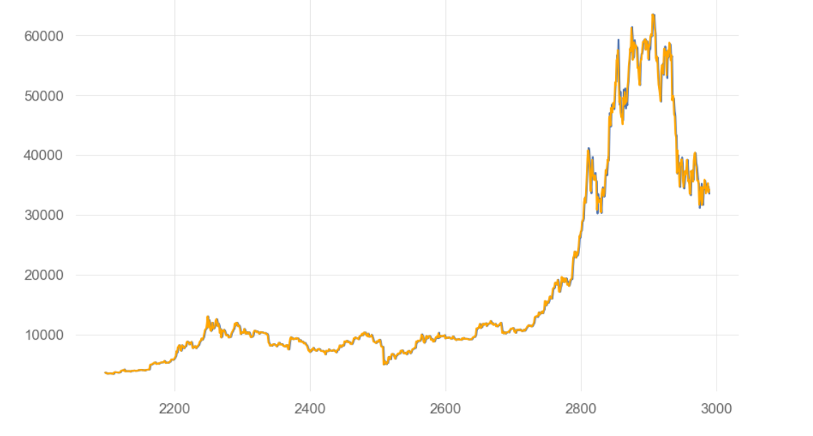
Neural Network – Prediction result
The close price predicted by the neural network models.
Close price produced by LSTM, BD LSTM, CNN, MLP, ED LSTM, Convolutional LSTM
Close price predicted by ARIMA (orange line)

Slide 8
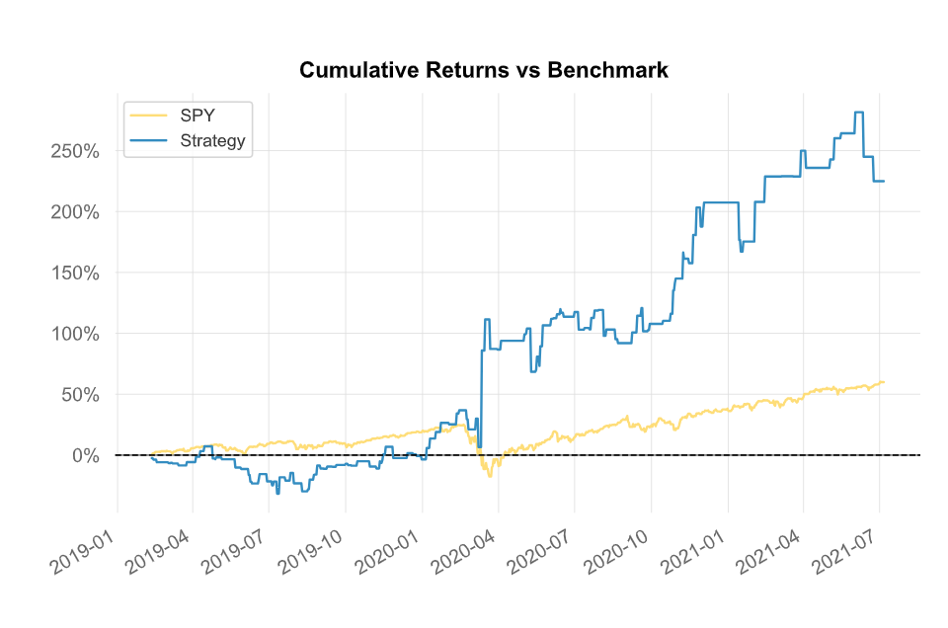
Neural Network – Results (by quantstats)

Slide 9
Neural Network – Concerns
Training model will take a very long time (> 1h)
Although the general trend follows the actual bitcoin price change, the neural network does not perform well on the short-time period prediction since I did the rolling prediction.
It does not catch the volatility of the bitcoin trend

Slide 10
Neural Network – Next Steps
Adding more layers when training the neural network models
Feed more features to the models
Combine the neural network and other learning method to increase the accuracy

Slide 11
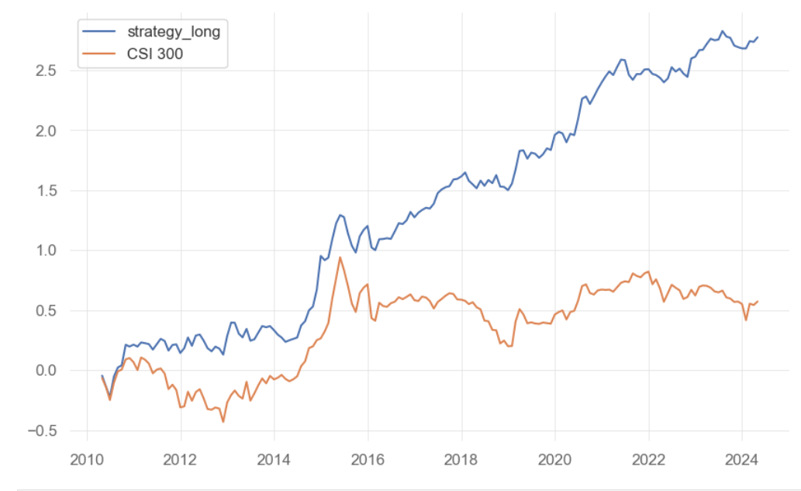
Deep Reinforcement Learning
Long Only Strategy (2010-04 – 2024-04)
Buy top 20 stocks. If the stock does not exist in the next month, then the stock is deleted from to buy list.
Sharpe Ratio: 3.94
Rank IC average: 0.12
CAGR: 12.56%
Max Drawdown: -28.76%
Long-Short Strategy(2010-04 – 2024-04)
Buy top 20 stocks and short bottom 20 stocks. If the stock
does not exist in the next month, then the stock is deleted
from to buy list and to sell list.
Sharpe Ratio: 9.35
CAGR: 24.93%
Max Drawdown: -23.02%

Slide 12
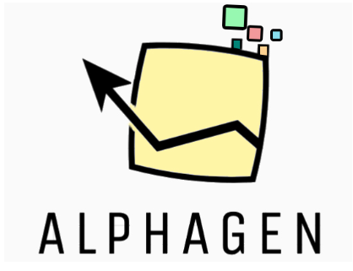
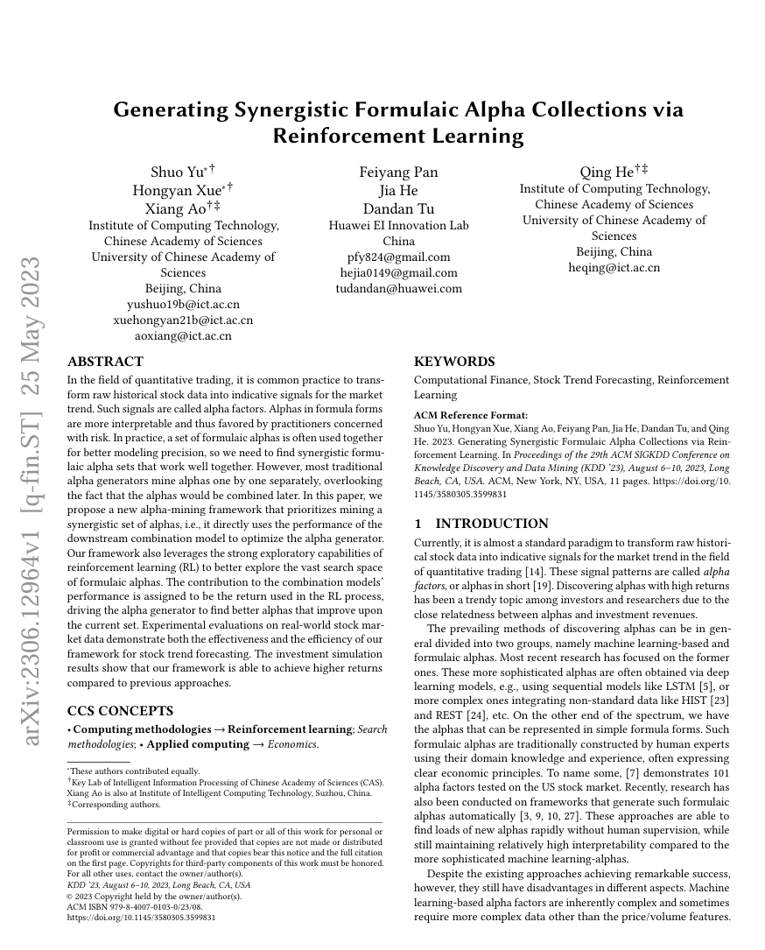
Deep Reinforcement Learning - Overview
The model is based on the paper: ‘Generating Synergistic Formulaic Alpha Collections via Reinforcement Learning’.
2306.12964 (arxiv.org)
Basic Logic:
Alpha Generator
(Deep Reinforcement Learning)
an alpha factor
Reward
Rank IC
Combination Model
(Linear Combination)
A Combination of Alpha Factors

Slide 13
Deep Reinforcement Learning – Strategy Build
Strategy Outlook:
Train the model using 12-months rolling window
Use the previous 12 months data to predict the next month return
Set the pool capacity, steps, seed
Pick the alpha factors combination with highest rank IC on the training data
If the highest rank IC is smaller than 0.1 (vary by person) with the assigned steps, re-train the model with different time window or the alpha pool size until the rank ic meets the set level
use the features from
To
Predict the return of
2010-03-31
…………………………..
2011-03-31
2010-04
……………………………….
2011-04
Codes: https://github.com/yilu0624/deep_reinforcement_learning.git

Slide 14
Deep Reinforcement Learning – Backtesting
BackTest:
Pick the prediction time: 2010-04 – 2024-04
Calculate the score using the combination of the alpha factors on this month
Sort the score from the highest to lowest
Pick the top 20 stocks to buy in next month, and bottom 20 stocks to short in the next month
Ex. Using the data from 2010-03 to calculate the alpha scores and pick the stocks that we are going to buy or short in the next month.
I will clear all the positions at the end of each month.

Slide 15
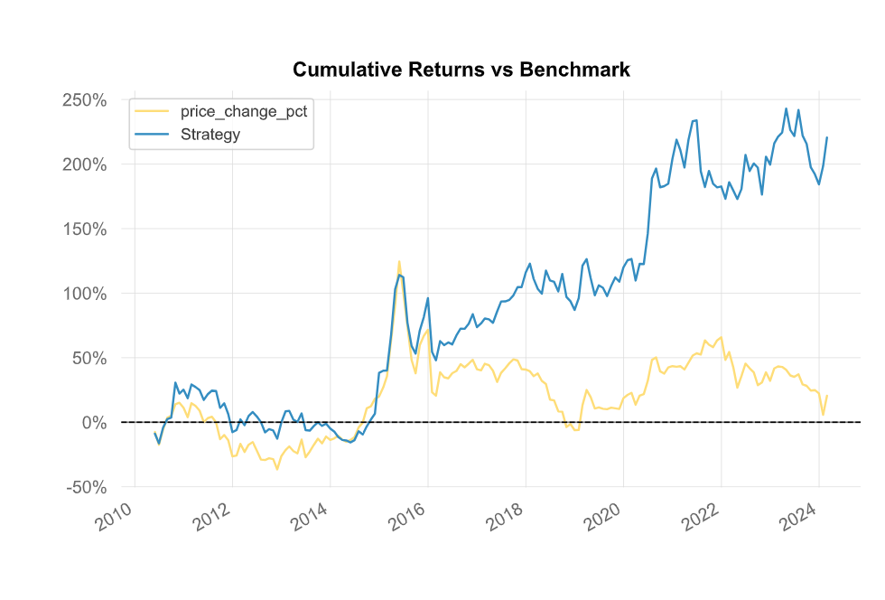
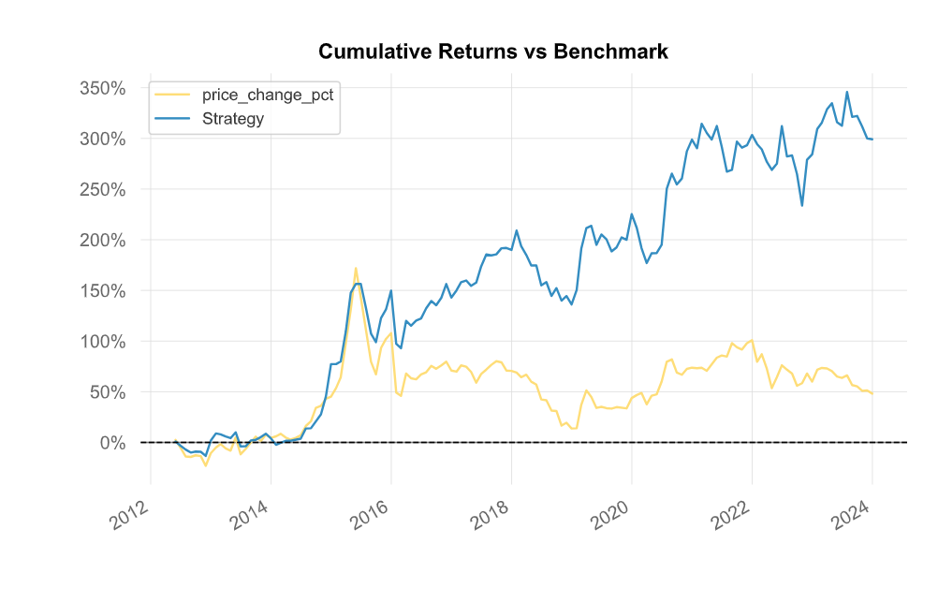
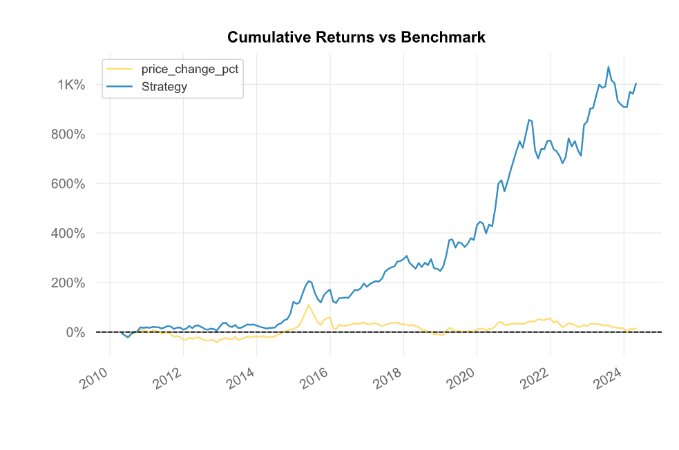
Deep Reinforcement Learning – Result(by quantstats)
The top two graph: I train the model and apply the combination alpha factors to the test data. Based on the rank IC of the test data to pick the combination of alpha factors I want to use in the next months.
The bottom graph: Train the model, and pick the combination of alpha factors based only on the rank ic on the training data.

Slide 16
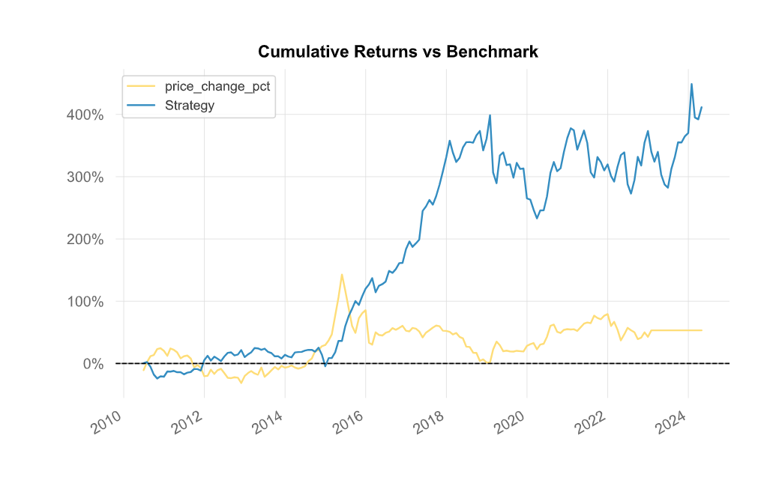
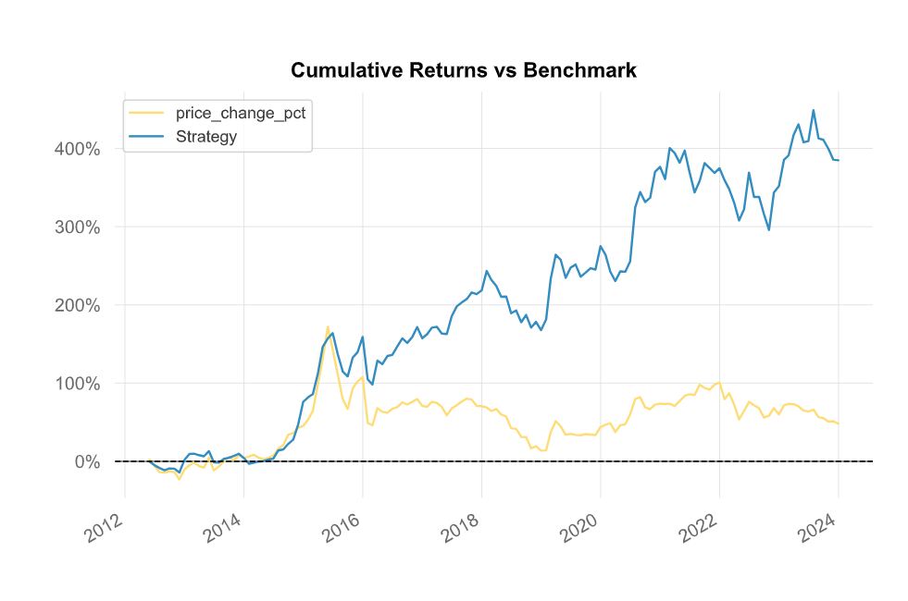
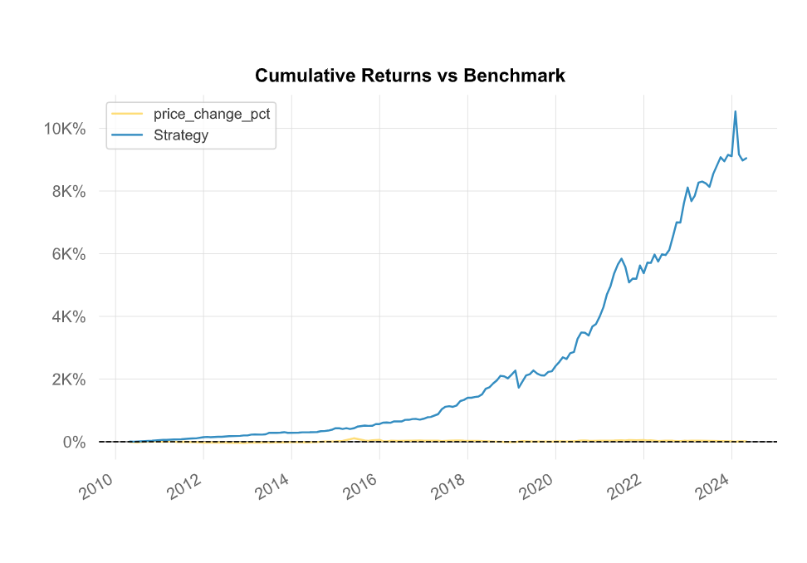
Deep Reinforcement Learning – Result(by quantstats)

Slide 17
Deep Reinforcement Learning – Concerns
Randomness in the model
The process of generating the action is random.
The different length of the rolling window will generate different alpha factors combination with the similar rank ic, therefore it is hard to pick which combination to use.
Validation set
In the latest try, I did not add the validation data set into the model. Therefore, I am not sure whether the validation set will affect the outcome of the prediction
Pool Capacity
Larger capacity will cause the model to run too long (more than 45 minutes on cpu)
Also, the longer steps will cause the model to run even longer while the rank ic on training data does not change by too much.
Stock Picks
Does not consider the type of industry, the trading cost and the possibilities of shorting the stocks

Slide 18
Deep Reinforcement Learning – Next Steps
Find the optimal way to pick the alpha factors combinations
Adding the validation set to see whether the result is improved
Try different pool capacity (> 100)
Mine the alpha factors with more steps
Adding the industry factor and trading cost and consider the possibilities of shorting the stocks picked by the model.

Slide 19
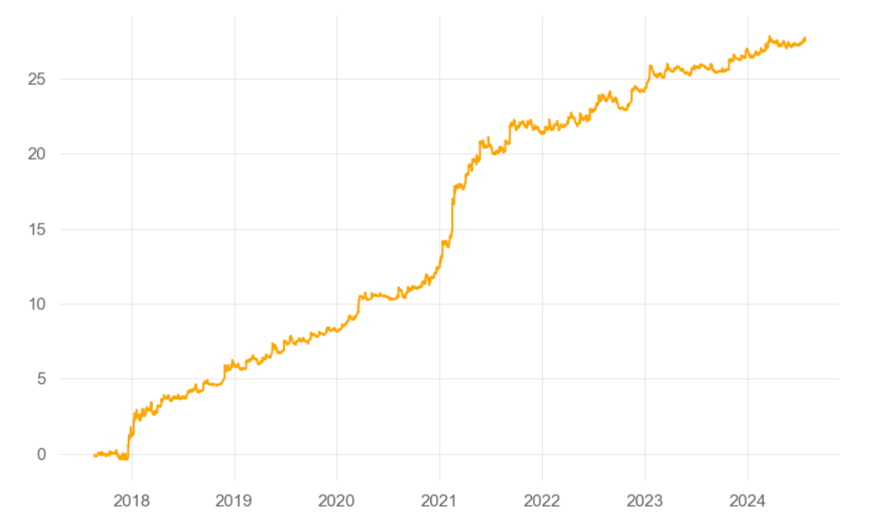
Technical Indicator
Long_Short Crypto Strategy
Buy and Sell based on the signal sent by the indicator on four cryptos: BTC, ETH, SOL, BNB
Sharpe Ratio: 7..17
Annul. Return: 60%
MaxDrawDown: -30.94%

Slide 20
Technical Indicator
Price Oscillator:
Calculation: (EMA_short – EMA_long) / EMA_long * 100
Signal: When the price oscillator goes up through the 0 level line, I will long that crypto. When the price oscillator goes down through the 0 line, I will sell that crypto. Also, when the price oscillator goes down through the 0 line, I will start to short that crypto, and when the price oscillator goes up through the 0 line, I will close the position.

Slide 21
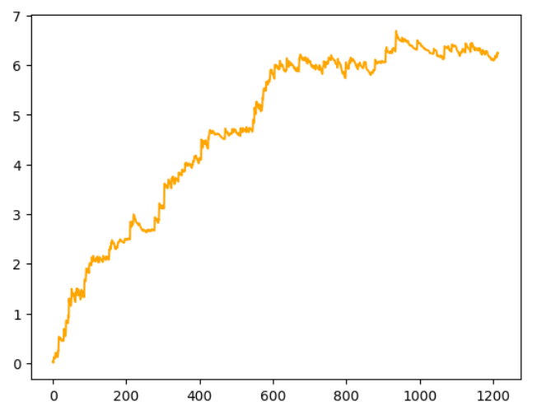
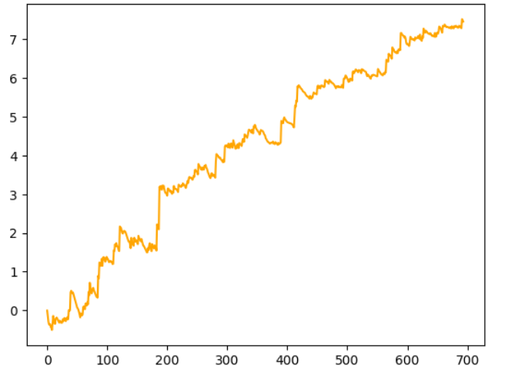
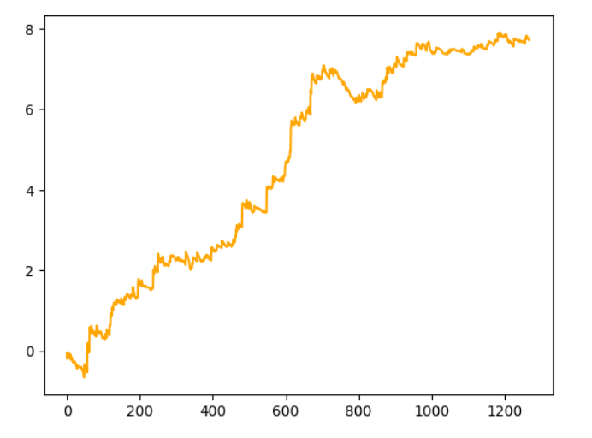
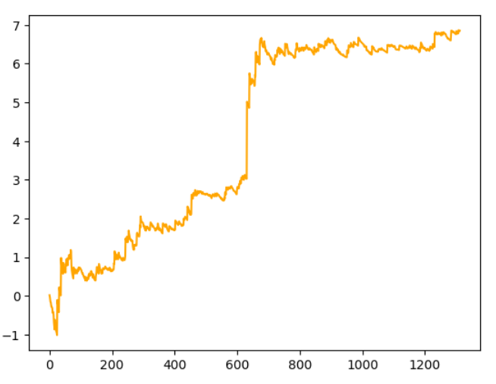
Technical Indicator – Result (PO)
BTC
SOL
Overall
ETH
BNB

Slide 22
Technical Indicator
Other indicators I have tried
SMA | DPO
T3 | POS
PAC | FAMA
SMA on Neural Network | RSI and VWAP
Codes: https://github.com/yilu0624/technical_indicator_crypto.git

Slide 23
Technical Indicator – Next Steps
I am going to employ the deep reinforcement learning on selecting the technical indicators for the crypto, and find a method to combine different technical indicators to give the signal indicating when to buy and sell
Also, I am going to includes more types of crypto currency to test

Slide 24
Q & A
Thanks for your time
&
happy weekend!

